Slide 1
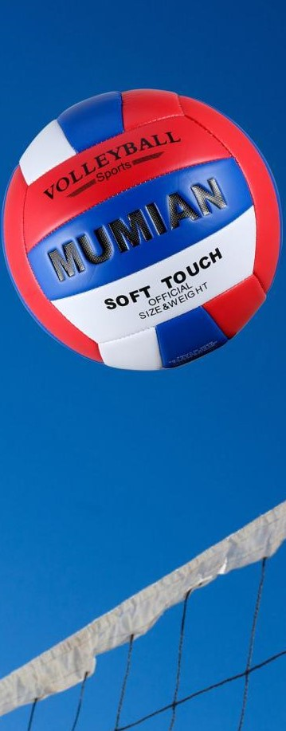
Westside High School
March 6-10 Week At a Glance (WAG)

Slide 2
Coach Thomas
Rec. Games: March 6-10

Slide 3
Monday - Agenda
Learning Target
I can use proper technique for stretching
Mar 6
Standard:
Opening ( 10-15 mins)
Student will go through stretches with coach lead
Work-session ( 20 - 25 mins)
½ mile run timed (6 laps in new gym)
2. Students will perform exercises from fitness program designed by themselves
3.Students will record information from fitness program, Burn out, max, and ½ mile run
Criteria for Success
1. Students can follow fitness program created by themselves using the proper technique for the exercises and striving to meet SMART strength and conditioning goal
Closing ( 05 – 10 mins)
Cool down

Slide 4
Tuesday - Agenda
Learning Target
Mar 7 Standard:
PERG.1 The physically educated student demonstrates competency in a variety of motor skills and movement patterns.
a. Demonstrates competence while performing skills in a variety of recreational game settings and activities
b. Performs skills at a level of competence, which contributes to health-related fitness.
c. Demonstrates proper warm-up and cool-down protocol associated with different life time
sport physical activities.
PERG. 2 The physically educated student applies the knowledge of concepts, principles, strategies, and tactics related to movement and performance.
Integrates a variety of strategies, tactics, concepts, and skills during recreational games activities
Evaluates skills needed for recreational games and leisure activities
PERG.3 The physically educated student demonstrates knowledge and skills to help achieve
and maintain a health-enhancing level of physical activity and fitness.
a. Maintains or improves fitness level by using the results of the Georgia Fitness Assessment
to guide changes in a personal program of physical activity.
b. Uses technologies to assess, enhance, and maintain health-related and skill-related fitness.
c. Analyzes the relationship between physical activity and longevity.
Personal and Social Behavior, Rules, Safety, and Etiquette
I can use the proper techniques to do the following
-stretch, complete circuit exercises,
2. I can compete as a team and follow game rules of speed ball
Opening ( 10-15 mins)
5-10 minute static & dynamic stretches (5 minutes locker rooms)
Work-session ( 20 - 25 mins)
1. Students will perform exercises from fitness program designed by themselves
2.Students will record information from fitness program
Criteria for Success
Students are able to use team strategy to compete in game of speed ball
Closing ( 05 – 10 mins)
locker room unlocked for 5 minutes
-students use remaining time to cool down & rehydrate if necessary

Slide 5
Wednesday - Agenda
Learning Target
Mar. 8 Standard:
PERG.1 The physically educated student demonstrates competency in a variety of motor skills and movement patterns.
a. Demonstrates competence while performing skills in a variety of recreational game settings and activities
b. Performs skills at a level of competence, which contributes to health-related fitness.
c. Demonstrates proper warm-up and cool-down protocol associated with different life time
sport physical activities.
PERG. 2 The physically educated student applies the knowledge of concepts, principles, strategies, and tactics related to movement and performance.
Integrates a variety of strategies, tactics, concepts, and skills during recreational games activities
Evaluates skills needed for recreational games and leisure activities
PERG.3 The physically educated student demonstrates knowledge and skills to help achieve
and maintain a health-enhancing level of physical activity and fitness.
a. Maintains or improves fitness level by using the results of the Georgia Fitness Assessment
to guide changes in a personal program of physical activity.
b. Uses technologies to assess, enhance, and maintain health-related and skill-related fitness.
c. Analyzes the relationship between physical activity and longevity.
Personal and Social Behavior, Rules, Safety, and Etiquette
I can use the proper technique for curl ups
I can use the proper technique for push ups
I can push myself to do my very best for each exercise for assessing my fitness level
Opening ( 10-15 mins)
Static & Dynamic Stretches
Work-session ( 20 - 25 mins)
. Students will perform exercises from fitness program designed by themselves
3.Students will record information from fitness program
Criteria for Success
Closing ( 05 – 10 mins)
Students will use the proper technique to perform fitness gram exercises
-curl ups
-push ups
-locker room unlocked for 5 minutes
-students use remaining time to cool down & rehydrate if necessary

Slide 6
Thursday - Agenda
Learning Target
Same as Tuesday & Wednesday
Mar. 9 Standard:
PERG.1 The physically educated student demonstrates competency in a variety of motor skills and movement patterns.
a. Demonstrates competence while performing skills in a variety of recreational game settings and activities
b. Performs skills at a level of competence, which contributes to health-related fitness.
c. Demonstrates proper warm-up and cool-down protocol associated with different life time
sport physical activities.
PERG. 2 The physically educated student applies the knowledge of concepts, principles, strategies, and tactics related to movement and performance.
Integrates a variety of strategies, tactics, concepts, and skills during recreational games activities
Evaluates skills needed for recreational games and leisure activities
PERG.3 The physically educated student demonstrates knowledge and skills to help achieve
and maintain a health-enhancing level of physical activity and fitness.
a. Maintains or improves fitness level by using the results of the Georgia Fitness Assessment
to guide changes in a personal program of physical activity.
b. Uses technologies to assess, enhance, and maintain health-related and skill-related fitness.
c. Analyzes the relationship between physical activity and longevity.
Personal and Social Behavior, Rules, Safety, and Etiquette
Opening ( 10-15 mins)
Static & Dynamic stretching
Work-session ( 20 - 25 mins)
1. Students will perform exercises from fitness program designed by themselves
2.Students will record information from fitness program
Criteria for Success
Closing ( 05 – 10 mins)
Same as previous day
-locker room unlocked for 5 minutes
-students use remaining time to cool down & rehydrate if necessary

Slide 7
Friday - Agenda
Learning Target
Mar. 10 Standard:
PERG.1 The physically educated student demonstrates competency in a variety of motor skills and movement patterns.
a. Demonstrates competence while performing skills in a variety of recreational game settings and activities
b. Performs skills at a level of competence, which contributes to health-related fitness.
c. Demonstrates proper warm-up and cool-down protocol associated with different life time
sport physical activities.
PERG.3 The physically educated student demonstrates knowledge and skills to help achieve
and maintain a health-enhancing level of physical activity and fitness.
a. Maintains or improves fitness level by using the results of the Georgia Fitness Assessment
to guide changes in a personal program of physical activity.
b. Uses technologies to assess, enhance, and maintain health-related and skill-related fitness.
c. Analyzes the relationship between physical activity and longevity.
Personal and Social Behavior, Rules, Safety, and Etiquette
Freestyle Friday
Opening ( 10-15 mins)
Attendance
Work-session ( 20 - 25 mins)
1. Students will perform exercises from fitness program designed by themselves
2.Students will record information from fitness program, Burn out, max, and ½ mile run
Criteria for Success
I can demonstrate my understanding of the rules, procedures, and expectations by following them during class time and asking questions to teacher if necessary.
Closing ( 05 – 10 mins)
N/A

Slide 8
Resources
https://www.youtube.com/watch?v=az_oouQa6VY

